Slide 1
HANDWRITTEN TEXT EXTRACTION USING OCR AND MACHINE LEARNING TECHNIQUES
TEAM MEMBERS:
NISHANTHAN T -810021106053
SIVAPRAKASH A -810021106079
TONY CHACKO THOMAS -810021106089
NAME AND DESIGNATION OF GUIDE:
DR. E. JEBAMALAR LEAVLINE,
ASSISTANT PROFESSOR(Sl.Gr)
DEPARTMENT OF ECE

Slide 2
AGENDA
Objectives
Introduction
Literature Survey
Problem Statement
Proposed Work
Methodology
Work-flow
Model Evaluation
Output
Conclusion
References

Slide 3
OBJECTIVES
Develop a Robust HTR Model – Design a deep learning-based handwritten text recognition system that handles diverse handwriting styles.
Overcome OCR Limitations – Enhance recognition accuracy beyond traditional OCR methods using advanced neural networks.
Support Multilingual Recognition – Build an adaptable model capable of recognizing Tamil and other scripts efficiently.
Improve Text Segmentation – Develop effective preprocessing and segmentation techniques to accurately separate characters and words.

Slide 4
INTRODUCTION
Tamil Handwritten Text Recognition (HTR) is challenging due to script complexity and handwriting variations.
Traditional OCR methods are ineffective in handling handwritten text, necessitating deep learning approaches.
This project aims to develop a robust HTR model using advanced deep learning techniques.
Multilingual and script adaptability will be incorporated for broader application.
Real-time processing optimization will ensure practical usability in real-world scenarios.

Slide 5
LITERATURE SURVEY
Name of the Paper | Author(s) | Year | Proposed System | Cons | Pros
Benchmarking on offline handwritten tamil character recognition using convolutional neural networks | Kavitha B.R, Srimathi C | 2019 | Developed a CNN model for offline character recognition | Cannot Handle full words or sentences | More accurate for individual character recognition
Training full-page handwritten text recognition models without annotated line breaks | C. Tensmeyer, C. Wigington | 2019 | Developed a model capable of recognizing full-page handwriting without requiring line annotations. | Performance drops when text spacing varies significantly. | Capable of recognizing full-page handwriting without requiring line annotations.
CNN-RNN based handwritten text recognition | G.R. Hemanth, M. Jayasree, S. Keerthi | 2021 | Developed a CNN-RNN model for handwritten text recognition. | Limited testing on diverse handwriting styles. | Effective model for recognizing handwritten text
A review on machine learning styles in computer vision—techniques and future directions | S.V. Mahadevkar et al. | 2022 | Reviewed various machine learning techniques in computer vision and their future applications. | The review lacks experimental validation for the techniques discussed. | Provides an overview of various ML techniques and future applications in computer vision.
Enhancement of handwritten text recognition using AI-based hybrid approach | Supriya Mahadevkar,Shruti Patil,Ketan Kotecha | 2024 | Introduces a hybrid approach for handwritten text recognition,employing CNN and BiLSTM with CTC | Works only on well-preprocessed data | Uses BiLSTM to capture sequential data

Slide 6
PROBLEM STATEMENT
Handwriting Variability – Differences in individual writing styles, stroke thickness, and spacing make accurate recognition challenging.
Limitations of Traditional OCR – Conventional OCR struggles with handwritten text due to irregular character shapes and cursive writing.
Multilingual and Script Challenges – Recognizing multiple languages and scripts, especially complex ones like Tamil, requires specialized models.

Slide 7
PROBLEM STATEMENT
Need for Deep Learning Models – Advanced deep learning techniques like CNNs and BiLSTMs are essential for improving handwritten text recognition accuracy.
Real-time Processing Requirement – HTR systems must be optimized for fast and efficient recognition, especially for mobile and embedded applications.
Text Segmentation Issues – Separating words, characters, and lines in handwritten text is difficult due to overlapping and connected strokes.

Slide 8
PROPOSED WORK
Boost Robustness: Implement advanced data augmentation to handle diverse handwriting and image quality.
Enhance Text Segmentation – Develop advanced preprocessing methods to accurately segment characters, words, and lines in handwritten text.
Ensure Real-time Performance – Optimize the model for faster inference to support real-time applications on low-power devices.
Optimize Deep Learning Architectures – Experiment with CNN, BiLSTM, and other hybrid models to improve efficiency and accuracy.

Slide 9
METHODOLOGY
TECHNOLOGY STACK:
Programming Language: Python
Libraries: OpenCV, TensorFlow, NumPy, Scikit-learn
Dataset: Handwritten regional language samples
Development Environment:Spyder IDE

Slide 10
METHODOLOGY
ALGORITHMS:
Convolutional Neural Network (CNN) – Extracts spatial features from handwritten Tamil text, detecting strokes, edges, and character patterns.
BiLSTM – Captures bidirectional sequential dependencies in the extracted features, enhancing contextual understanding of handwritten text.
Connectionist Temporal Classification (CTC) – Enables recognition without explicit segmentation by aligning predicted sequences with the ground truth labels.

Slide 11
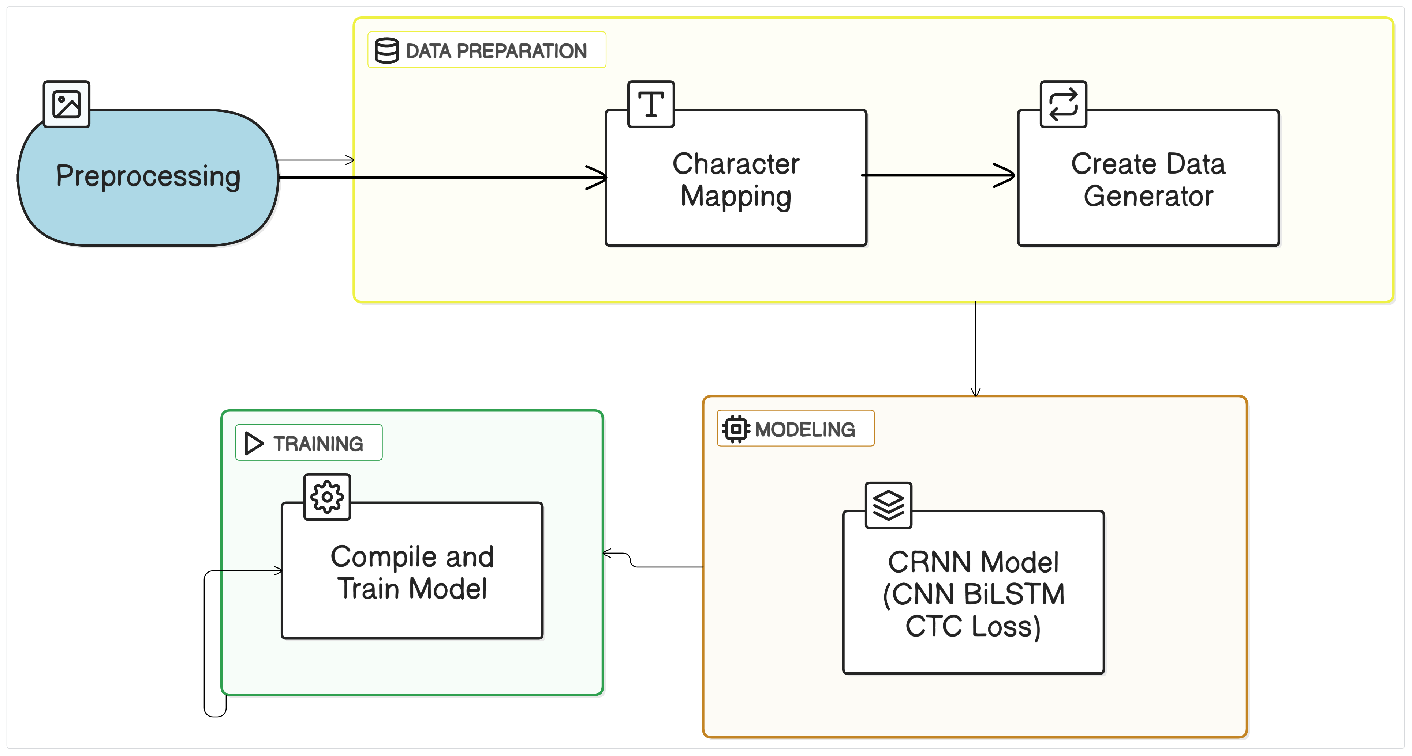
TRAINING WORKFLOW

Slide 12
Load Dataset
Load images of handwritten text from the dataset.
Split data into training, validation, and test sets and Label the dataset properly
Preprocess Images
The input handwritten images are resized, padded (if necessary
Normalized to fit the model's expected input shape and improve learning.
Character Mapping
A vocabulary is built from the dataset, mapping each unique character to a numeric ID and vice versa, essential for label encoding and decoding.

Slide 13
Create Data Generator
A data generator (e.g., HTRDataset) loads images and labels in batches, dynamically applying preprocessing and preparing data for model training.
CRNN (CNN + BiLSTM + CTC Loss)
The model architecture consists of a Convolutional Neural Network (CNN) for feature extraction, a Bidirectional LSTM for sequence modeling, and a CTC loss layer to handle unsegmented sequence labeling.

Slide 14
Compile and Train Model
The model is compiled using the Adam optimizer and trained with callbacks like early stopping and model checkpoints to optimize learning.
Model Saving & Versioning
Save the best-performing model (architecture + weights) in the .keras format for reliable future inference and continued development.

Slide 15
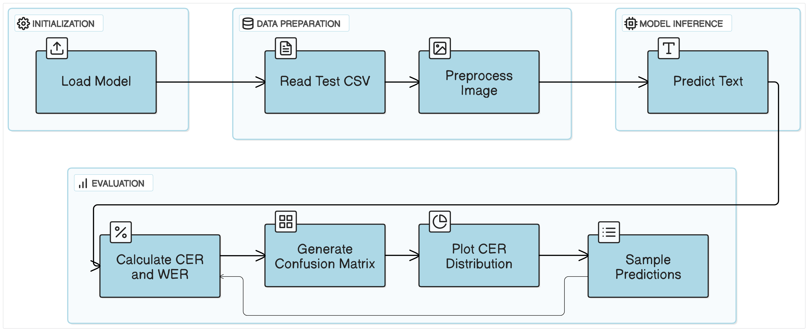
PREDICTION WORKFLOW

Slide 16
Load Model The best-trained CRNN model is loaded with a custom CTC loss layer for inference.
Read Test CSV The test CSV is parsed to obtain file paths and ground truth labels for evaluation.
Preprocess Image Each test image is resized, padded, and normalized similarly to training preprocessing for consistency.

Slide 17
Predict Text Preprocessed images are fed into the model, and predictions are decoded using a greedy CTC decoder to get readable text.
Calculate CER & WER Character Error Rate (CER) and Word Error Rate (WER) are computed to evaluate the model's text recognition accuracy.
Generate Confusion Matrix A character-level confusion matrix is plotted to visualize common misclassifications made by the model.

Slide 18
Plot CER Distribution A histogram of CER values is generated to understand the distribution and frequency of recognition errors across the test set.
Sample Predictions Correct and incorrect predictions are visualized with the original images, ground truths, and predictions to analyze model behavior qualitatively.

Slide 19
Model Evaluation
Validate model performance using test data to measure accuracy and loss using perfomance metrics.
Character-Level Metrics
Character Error Rate (CER) = (Number of incorrect characters) / (Total characters in ground truth)
Character Accuracy = (Correctly recognized characters) / (Total characters in ground truth)
Word-Level Metrics
Word Error Rate (WER) = (Substitutions + Insertions + Deletions) / (Total words in ground truth)
Word Accuracy = (Correctly recognized words) / (Total words in ground truth)

Slide 20
MODEL EVALUATION
Perfomance Metrics:
Metric | Value
Character Error Rate (CER) | 0.0288
Character Accuracy | 97.12%
Word Error Rate (WER) | 0.1661
Word Accuracy | 83.39%

Slide 21
MODEL EVALUATION
Per-Image Analysis :
File | Ground Truth | Prediction | CER
test/1.jpg | பச்சனுக்கும் | பச்சவுக்கும் | 0.0833
test/2.jpg | மக்களொடு | மக்களடு | 0.1250
test/3.jpg | இறந்தவர்களது | இறந்தவர்களது | 0.0000
test/4.jpg | விந்திய | விந்திய | 0.0000
test/5.jpg | யு | ௶ு | 0.5000
test/6.jpg | கம்பெனிகளுக்கு | கம்பெனிகளுக்கு | 0.0000
test/7.jpg | காகிதத்தில் | காகிதத்தில் | 0.0000
test/8.jpg | ஊருக்குக் | ஊருக்குக் | 0.0000
test/9.jpg | இவருக்கு | இவருக்கு | 0.0000

Slide 22
MODEL EVALUATION
CER Distribution:
CER Distribution Plot shows:
X-axis: CER values (from 0 to 2 ).
Y-axis: Number of images.
It helps you understand how many images had low, medium, or high error rates.
For example, a peak at 0 means many images were predicted perfectly.

Slide 23
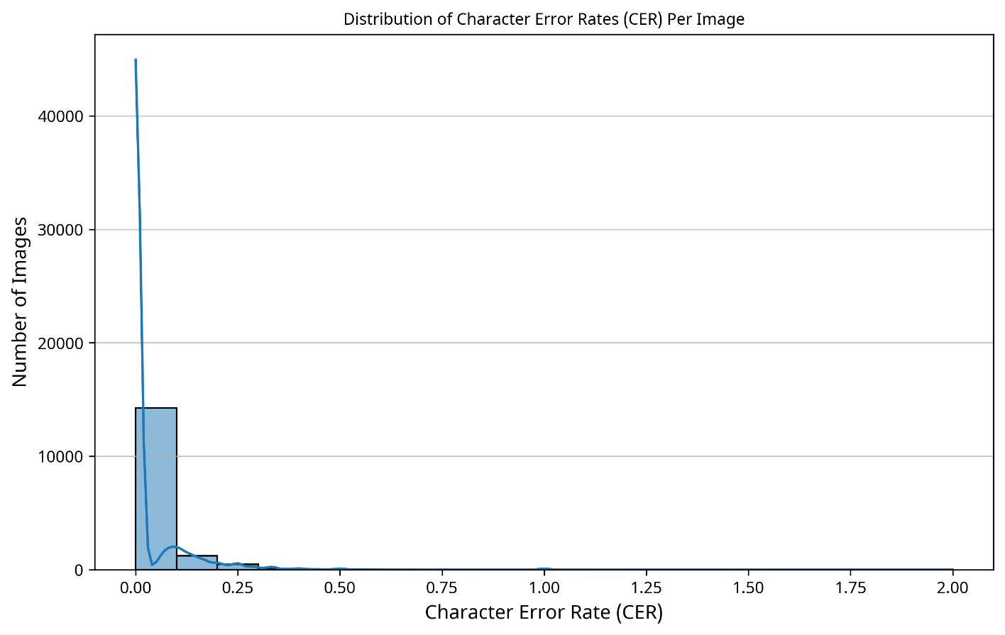
MODEL EVALUATION
CER Distribution:

Slide 24
MODEL EVALUATION
Confusion matrix:
Shows how often the model confuses one Tamil character for another.
Each row: actual (true) character.
Each column: predicted character.
The cells show how often the model predicted a wrong character.
Example: If the model often mistakes "க்" as "ஞ்", the value at (க், ஞ்) will be high.
It helps identify which characters are most commonly misclassified by the model.

Slide 25
MODEL EVALUATION
Confusion matrix:

Slide 26
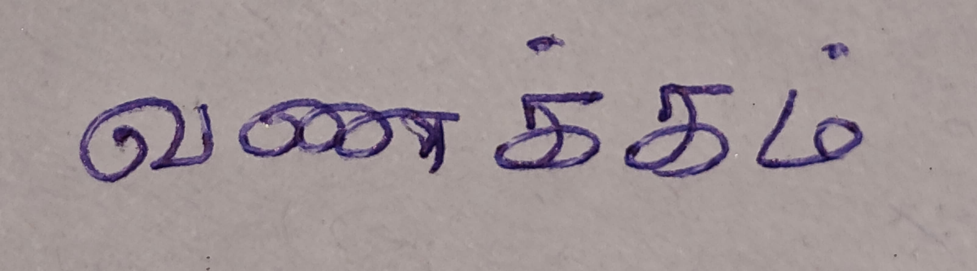
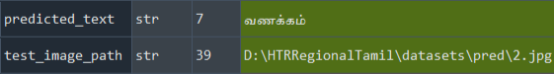
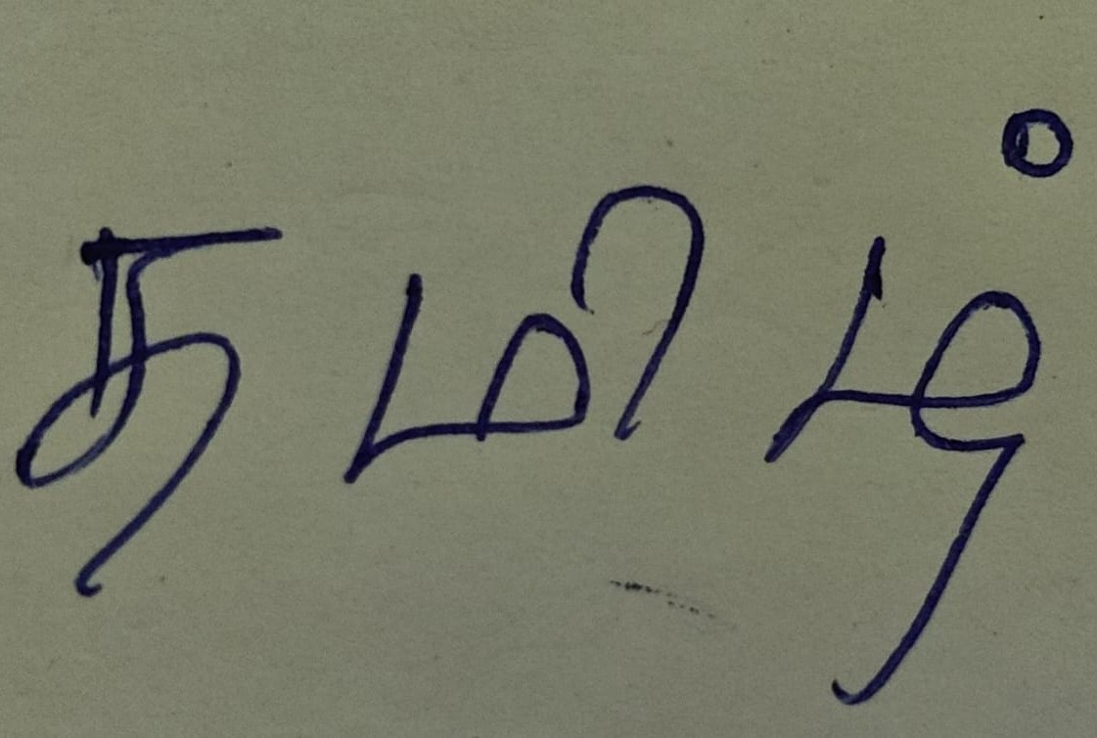
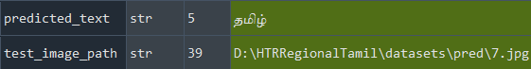
OUTPUT
2.jpg
7.jpg

Slide 27
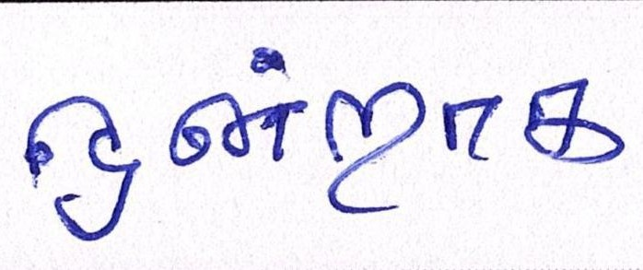
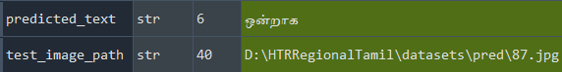
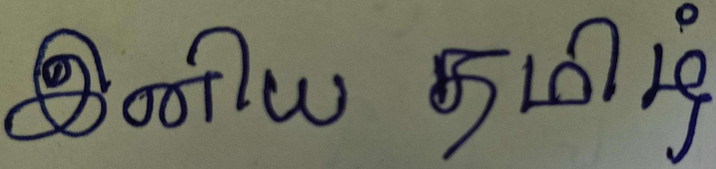
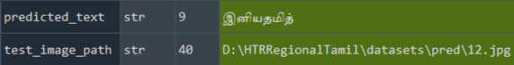
OUTPUT
87.jpg
12.jpg

Slide 28
CONCLUSION
End-to-End System:Integrated pipeline from image preprocessing to final evaluation - adaptable to other Indic scripts.
High Accuracy:Achieved Character Accuracy of 97.12% and Word Accuracy of 83.39%, demonstrating strong generalization.
Real-Time Input Systems:Deploy on devices using model optimization for instant handwriting recognition.
Multilingual & Multi-Script Support:Expand to scripts like Hindi, Telugu, Malayalam with shared architectures and transfer learning.

Slide 29
REFERENCES
BASE PAPER
Kavitha B.R., Srimathi C., "Benchmarking on Offline Handwritten Tamil Character Recognition using Convolutional Neural Networks", Journal of King Saud University – Computer and Information Sciences 34 (2022) 1183–1190.
C. Tensmeyer, C. Wigington , “Training full-page handwritten text recognition models without annotated line breaks” , DOI:10.1109/ICDAR.2019.00011Conference: 2019 International Conference on Document Analysis and Recognition (ICDAR)
G.R. Hemanth, M. Jayasree, S. Keerthi Venii, P. Akshaya, and R. Saranya ,“CNN-RNN based handwritten text recognition” ISSN: 2229-6956 (ONLINE) ICTACT JOURNAL ON SOFT COMPUTING, OCTOBER 2021, VOLUME: 12, ISSUE: 01 DOI: 10.21917/ijsc.2021.0351
S.V. Mahadevkar, et al., “A review on machine learning styles in computer vision —techniques and future directions”, IEEE Access 10 (2022) 107293–107329, doi: 10.1109/ACCESS.2022.3209825 .
Supriya Mahadevkar, S. Patil, and K. Kotecha, "Enhancement of handwritten text recognition using AI-based hybrid approach," MethodsX, vol. 12, p. 102654, 2024. doi: 10.1016/j.mex.2024.102654

Slide 30
THANK YOU

